Slide 1
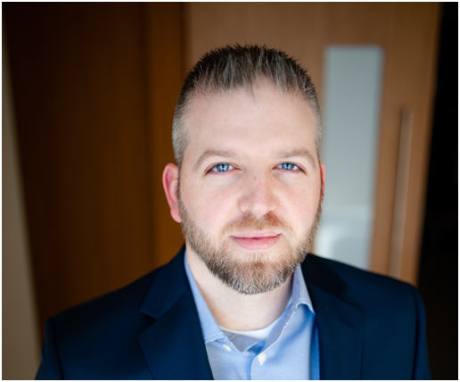
Tony High Senior Consultant — Acceleration
Email
tony.high@thebridge.com
Location
Catlin, Illinois
Mobile
(217) 304-3573
Tony joined The Bridge in April 2021. He has previously worked at various healthcare, finance, & distribution support focused consulting firms where he has led or supported various projects as a PM, CM, BA, or Trainer.
EXPERIENCE
Industry Experience
Financial Services | Healthcare | Technology | Supply Chain | Distribution | Retail | Real Estate
RFID Implementation| Supply Chain (Convenience Store Chain Supplier)
Developed, setup, implemented, and helped run governance structure for RFID implementation.
Worked with product, marketing, and procurement teams to ensure their product had all expected inventory and RFID tags applied and in their supply chain.
Implemented an update to client’s master data system so they were able to track what products were RFID and which ones weren’t.
Oversaw and tracked the RFID tags from the vendor to the field.
Worked with the field implementation team and monitored completion of the stores inventory being converted to RFID enabled product.
Conducted time studies in the field and performed analytics to help determine the ROI.
Performed adhoc analysis on shrink, store full rates, RFID inventory, store completion, and various other data requests.
Digital Specialty Transformation | Healthcare (Specialty RX)
Supported 12 Specialty Transformation releases for multiple Digital workstreams such as IVR, Texting/Email, Video Chat, Web, & App.
Worked directly with business product owners and technical product owners to drive new capabilities, enhancements, and bug fixes to completion.
Setup and supported day of release events (war room) to manage any major issues caused by the release to ensure its success.
Worked with communication teams to develop release specific information graphics, videos, and SOPs.
Trained various digital support teams on release specific support items.
Coordinated with the value tracking team to ensure current metrics were setup and tracked.
BACKGROUND
Functional Skills
Project Management (Waterfall & Agile), Change Management, Design Thinking, Data Analysis, Metric Setup/Reporting, Organizational Effectiveness, Business Processes, Quality Assurance, Training, Communications, Graphic Design, Digital Product Support
Qualifications
Ability to provide support in multiple areas based on the clients need. Tony has been a PM, CM, and BA in various divisions of healthcare in the retail and specialty pharmacy areas and most recently in the natural and conventional foods sector. He has provided business readiness support for digital products and was the lead trainer for a new software implementation for medical records fulfillment.

Slide 2

Email
tony.high@thebridge.com
Location
Catlin, Illinois
Mobile
(217) 304-3573
Tony joined The Bridge in April 2021. He has previously worked at various healthcare, finance, & distribution support focused consulting firms where he has led or supported various projects as a PM, CM, BA, or Trainer.
Tony High Senior Consultant
Acceleration

Slide 3
Tony High Senior Consultant — Acceleration
Email
tony.high@thebridge.com
Mobile
(217) 304-3573
Location
Catlin, Illinois
BACKGROUND
EXPERIENCE
Functional Skills
Project Management (Waterfall & Agile), Change Management, Design Thinking, Data Analysis, Metric Setup/Reporting, Organizational Effectiveness, Business Processes, Quality Assurance, Training, Communications, Graphic Design, Digital Product Support
Qualifications
Ability to provide support in multiple areas based on the clients need. Tony has been a PM, CM, and BA in various divisions of healthcare in the retail and specialty pharmacy areas and most recently in the natural and conventional foods sector. He has provided business readiness support for digital products and was the lead trainer for a new software implementation for medical records fulfillment.
Industry Experience
Financial Services | Healthcare | Technology | Supply Chain | Distribution | Retail | Real Estate
RFID Implementation| Supply Chain (Convenience Store Chain Supplier)
Developed, setup, implemented, and helped run governance structure for RFID implementation.
Worked with product, marketing, and procurement teams to ensure their product had all expected inventory and RFID tags applied and in their supply chain.
Implemented an update to client’s master data system so they were able to track what products were RFID and which ones weren’t.
Oversaw and tracked the RFID tags from the vendor to the field.
Worked with the field implementation team and monitored completion of the stores inventory being converted to RFID enabled product.
Conducted time studies in the field and performed analytics to help determine the ROI.
Performed adhoc analysis on shrink, store full rates, RFID inventory, store completion, and various other data requests.
Digital Specialty Transformation | Healthcare (Specialty RX)
Supported 12 Specialty Transformation releases for multiple Digital workstreams such as IVR, Texting/Email, Video Chat, Web, & App.
Worked directly with business product owners and technical product owners to drive new capabilities, enhancements, and bug fixes to completion.
Setup and supported day of release events (war room) to manage any major issues caused by the release to ensure its success.
Worked with communication teams to develop release specific information graphics, videos, and SOPs.
Trained various digital support teams on release specific support items.
Coordinated with the value tracking team to ensure current metrics were setup and tracked.

Slide 4









 | USE OVER DARK BACKGROUND | USE OVER LIGHT BACKGROUND
STRATEGY & ADVISORY
DATA & AI
EXPERIENCES
CLOUD & PRODUCT
ACCELERATION

